Slide 1
AI Expense and budgeting system for Lab
Scope and Goal
Group name : Griffins
Team members :
Ahmad sajjad (2023-CS-81)
Ahmad hassan(2023-cs-77)
Atif awan(2023-cs-154)
Huzaifa Arshad(2023-cs-86)

Slide 2
AI budgeting and expense for lab
Project Vision and Goal (week 2 MVP)
Vision:
To develop a lab-based AI budgeting and expense management system that applies artificial intelligence to financial data for accuracy, efficiency, and intelligent decision-making.
Goal:
Demonstrate an MVP that automates expense management, optimizes lab budgeting, and improves decision support through data-driven insights.

Slide 3
Project Scope
Scope Includes:
Implement AI algorithms for automatic expense categorization.
Enable budget allocation, tracking, and real-time updates.
Provide a functional MVP dashboard for lab use.
Focused on small-scale lab deployment.
Showcase proof of concept (not enterprise-level).

Slide 4
Condensed AI Budgeting System Sprint Plan
Here is the most concise summary of the revised 6-week sprint plan, including the new Authentication sprint.
Sprint # | Duration | Scrum Master | Core Focus | Key Deliverables
1 | Week 1 | Ahmad Sajjad | Foundation | Define scope, set up infrastructure (GitHub), initial design.
2 | Week 2 | Atif Awan | Authenticatio n | Implement user Login/Logout, account creation, and security protocols.
3 | Week 3 | Ahmad Hassan | Backend | Build core APIs (Express.js) for expense/budg et, CRUD testing, and prepare AI datasets.
4 | Week 4 | Huzaifa Arshad | Frontend/UI | Develop Dashboard/R eporting UI, backend integration, data

Slide 5
Would you like to focus on the Scrum Master rotation or the AI Model Integration tasks?
 |  |  |  | visualization, and usability testing.
5 | Week 5 | Ahmad Sajjad | AI Integration | Embed AI model (prediction/bu dgeting), optimize data flow, and perform system testing.
6 | Week 6 | Ahmad Hassan | Finalization | Full end-to-end testing, final documentation , and System Demonstratio n.

Slide 6
Epic and Features
Epic 1: Expense Management
  Track and validate lab expenses automatically.
  Features: Auto-tracking, Categorization.
Epic 2: Budget Planning & Tracking
  Set targets, generate reports, monitor utilization.
  Features: Dashboard, Reports, Alerts.
Epic 3: AI Predictions & Insights
  Forecast lab spending, detect anomalies.
  Features: Forecasting, Recommendations.

Slide 7
MoSCoW Prioritization Table
Category | Must Have | Should Have | Could Have
Epic 1 | Auto-tracking | Categorization | Validation
Epic 2 | Dashboards | Reports | Alerts
Epic 3 | Forecasting | Recommendations | Anomaly Detection

Slide 8
Product Backlog – User Stories (Week 5 )
Sr No. | User Story | Epic | SP | Priority
1 | As lab manager, I want automated expense tracking so I can avoid manual entry. | 1 | 8 (L) | Must
2 | As researcher, I want AI-based categorization for better insights. | 1 | 5 (M) | Should
3 | As admin, I want a dashboard to monitor budgets in real-time. | 2 | 13 (XL) | Must
4 | As analyst, I want predictive alerts to detect anomalies. | 3 | 8 (L) | Could

Slide 9
Sprint 2 Plan
Priority Task | Story Points
Finalize Authentication System | 12 SP
Enhance Real-Time Visualization | 8 SP
Performance Optimization | 7 SP
Testing & QA Pipeline | 5 SP

Slide 10
Effort Estimation (Story Points)(Week 6 Estimation Slide)
Task Description | Effort (SP) | Size (T-Shirt)
Connect backend APIs with dashboard UI | 8 | Large (L)
Integrate AI model for expense prediction | 13 | Extra Large (XL)
Test and debug visualization charts | 5 | Medium (M)
Refine database structure for data flow | 3 | Small (S)
Sprint review and documentation | 2 | Extra Small (XS)

Slide 11
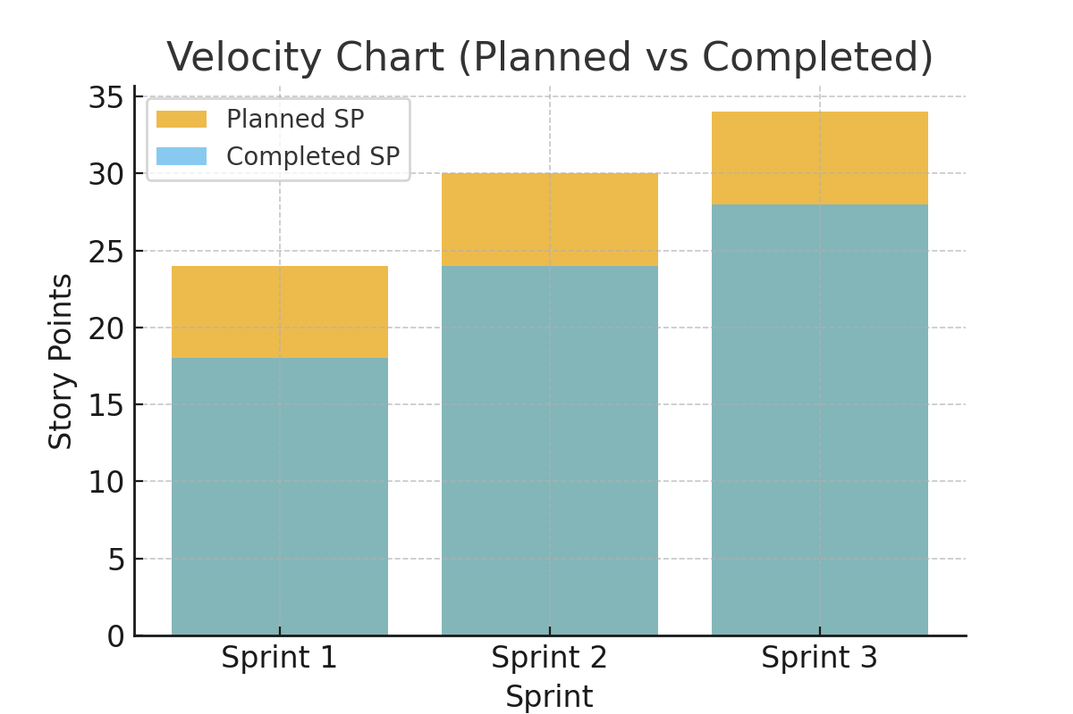
Velocity Chart
Velocity Chart
This chart represents the planned vs completed story points for three sprints with 75–82% accuracy

Slide 12
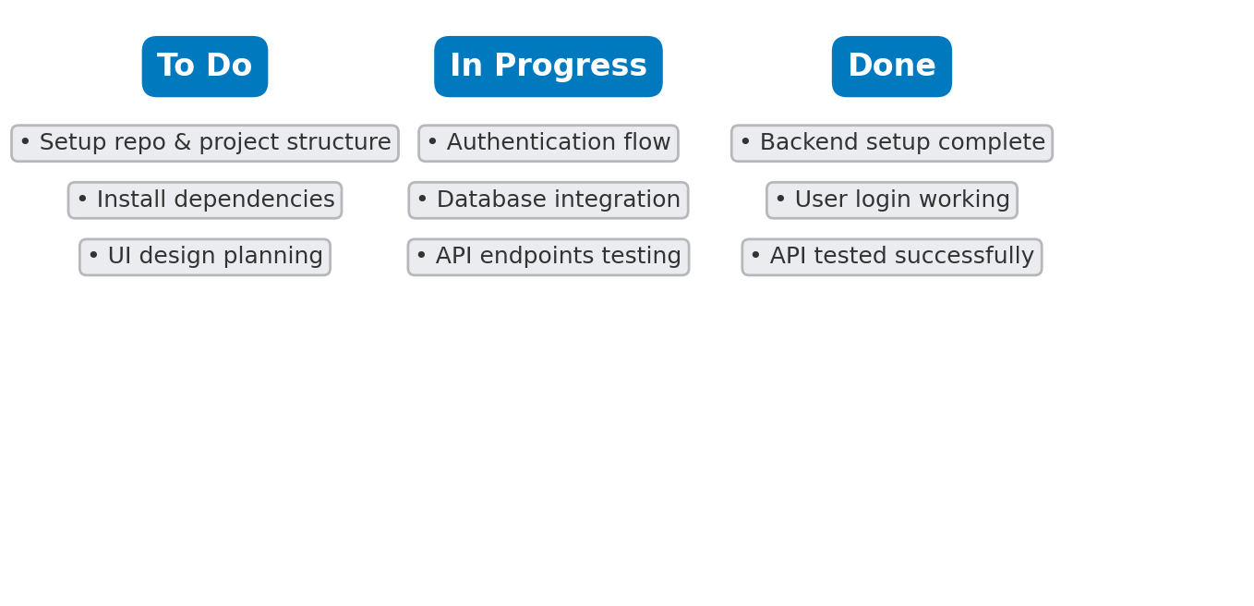
Kanban Board (Trello Style)
The following board represents the progress of key tasks across all sprints in a Trello-style view.
Sprint Overview Summary
Sprint | Main Focus | Planned SP | Velocity
Sprint 1 | Project Setup | 24 | 75%
Sprint 2 | Authentication System | 30 | 80%
Sprint 3 | Backend & API Setup | 34 | 82%

Slide 13
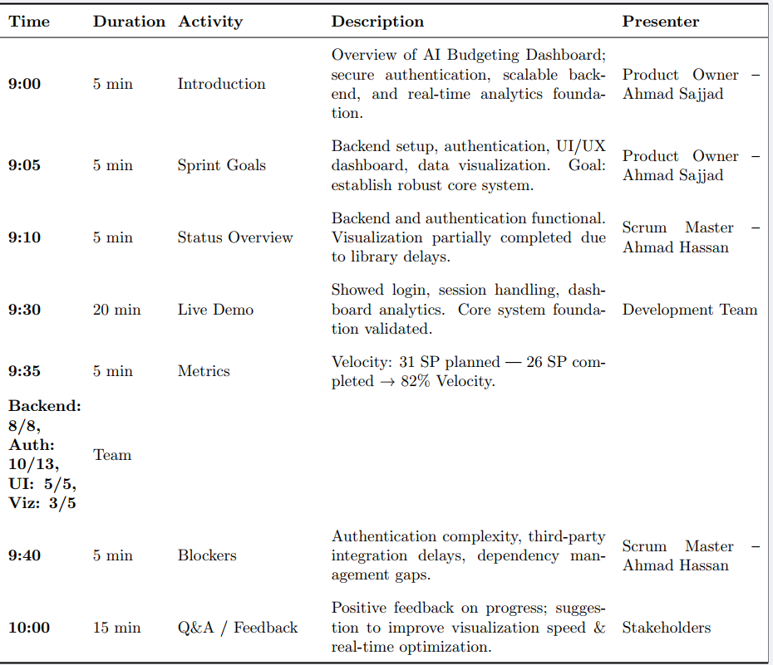

Slide 14
Sprint Retrospective (Sprint 1)
What Went Well | What Didn’t Go Well | Improvements for Next Sprint
• Backend infrastructure completed and tested • UI/UX design system implemented successfully • Strong team collaboration | • Authentication complexity underestimated • Visualization library delays • Missed early dependency checks | • Improve estimation accuracy • Identify dependencies early • Allocate buffer for complex integrations

Slide 15
Final Sprint Output
Goal: Deliver AI Dashboard MVP
Key Outputs:
  Backend connected to AI module.
  Real-time data visualizations.
  Expense categorization working.
  Predictive analytics initiated.

Slide 16
Conclusion
Completed 3 simulated sprints (Avg. Velocity: 74%)
AI Budgeting System MVP ready for demo.
Agile process successfully implemented with Trello tracking.
Team collaboration improved sprint by sprint.

